Slide 1


Department of CSE – (IoT & CSBT)
(An Autonomous Institute, Affiliated to VTU, Belagavi) Jnana Prabha, Bidarahalli, Bengaluru-49 Approved by AICTE, New Delhi & Government of Karnataka Accredited by NBA (CSE, ECE & ISE) and NAAC with A Grade
Project Presentation
On
“Empowering visually impaired with Safe , Smart Navigation”
By
Kushitha V (1EP22IC028)
Nandini V (1EP22IC031)
Punith Kumar NA(1EP22IC041)
Shreyas S S (1EP22IC050)
Under the Guidance of
Dr. Komala C R
Professor
Dept. of CSE- (IoT& CSBT)
EPCET, Bengaluru
www.eastpoint.ac.in

Slide 2
Contents
Introduction
Literature Survey
Proposed Method
Objectives
Motivation
Challenges
Applications
Hardware and Software Requirements
Architecture
Algorithm Used
Use case diagram
Sequence diagram
Implementation
Results
Result Analysis
Conclusion
References
Department of CSE – (IoT & CSBT) 2025-26

Slide 3
Introduction
Obstacle-avoiding robots are a fundamental application of autonomous robotics, designed to
navigate environments without human intervention. This project utilizes an Arduino Uno,
ultrasonic sensors (Ping library), and servo motors (Servo library) for efficient movement and
obstacle detection. The Motor Drive Shield library enables precise motor control, allowing the
robot to adjust its path dynamically. The ultrasonic sensor detects obstacles in real time, while the
servo motor adjusts the sensor’s direction for enhanced scanning. By integrating these components,
the robot can autonomously explore its surroundings, making it ideal for automation, security, and
development.
Department of CSE – (IoT & CSBT) 2025-26

Slide 4
Literature survey
Autonomous Obstacle Avoidance Using Ultrasonic Sensors – This research highlights the use of Ping ultrasonic sensors for obstacle detection, ensuring real-time navigation accuracy.
Integration of Servo Motors in Robotics – Discusses how Servo library enhances precise movement, improving obstacle avoidance strategies.
Motor Drive Shield for Efficient Motion Control – Examines the role of Motor Drive Shield library in optimizing motor responses for better mobility.
AI-Based Path Planning in Robotics – Explores how sensor data and algorithms enhance autonomous decision-making.
Department of CSE – (IoT & CSBT) 2025-26

Slide 5
Proposed system
The proposed system enhances autonomous robotic navigation by integrating Arduino Uno, ultrasonic sensors, servo motors, and a motor driver shield .The Ping library enables precise distance measurement, while the Servo library controls the servo motor to adjust sensor direction for wider obstacle detection. The Motor Drive Shield library facilitates efficient motor control, ensuring smooth movement adjustments. The robot follows a sense-think-act mechanism, where real-time sensor data enables quick decisions for obstacle avoidance. This system is ideal for automation, security patrols, smart mobility, and educational robotics, improving efficiency and reducing human intervention in hazardous environments
Department of CSE – (IoT & CSBT) 2025-26

Slide 6
Objectives
To design and build an autonomous robot using Arduino.
To integrate ultrasonic sensors for obstacle detection.
To program the robot to navigate by avoiding obstacles in real time.
To understand the working and interfacing of Arduino and motor drivers.
To encourage interest and learning in robotics and embedded systems.
Department of CSE – (IoT & CSBT) 2025-26

Slide 7
Motivation
The project is motivated by the need to provide safe and intelligent navigation support for visually-impaired individuals. Traditional tools like white canes cannot detect obstacles at a distance or guide users in real time. With low-cost sensors like ultrasonic modules and efficient motor control, a smart obstacle-avoiding robot can help users move safely, reduce accidents, and improve their independence in daily life.
Department of CSE – (IoT & CSBT) 2025-26

Slide 8
Challenges
Sensor inaccuracies due to noise, blind spots, or inconsistent distance readings.
Environmental issues like varying light, rough surfaces, and unexpected obstacles affecting detection.
Hardware limitations, including limited range of ultrasonic sensors and motor driver constraints.
Power management challenges in maintaining stable voltage for sensors and motors.
Integration issues while combining Arduino, sensors, and motors for synchronized operation.
Calibration difficulties to achieve accurate obstacle detection and smooth movement.
Department of CSE – (IoT & CSBT) 2025-26

Slide 9
Applications
Used for safe navigation for visually-impaired individuals.
Helps in autonomous robots to avoid obstacles in real time.
Useful in smart mobility systems like indoor delivery robots.
Supports industrial automation for collision-free robot movement.
Can be applied in surveillance and rescue robots for safe path navigation.
Department of CSE – (IoT & CSBT) 2025-26

Slide 10
Hardware and Software Requirements
Hardware Requirements
1.Arduino Uno – Main microcontroller for processing data.
2. Ultrasonic Sensor (HC-SR04 or Ping) – Detects obstacles using ultrasonic waves.
3. Servo Motor (SG90/MG995) – Rotates the ultrasonic sensor for wider detection.
4. Motor Driver Shield (L298N) – Controls the robot’s motor movement.
5. DC Motors with Wheels – Enables the robot’s movement.
6. Power Supply (9V Battery or Li-Ion Pack) – Provides necessary voltage for components.
7. Chassis and Mounting Accessories – Forms the robot’s structure.
Software Requirements
1.Arduino IDE – For coding and uploading programs.
2. Ping Library – Processes ultrasonic sensor data.
3. Servo Library – Controls servo motor movement.
4. Motor Drive Shield Library – Manages motor operations efficiently.
5. Microprocessor
Department of CSE – (IoT & CSBT) 2025-26

Slide 11
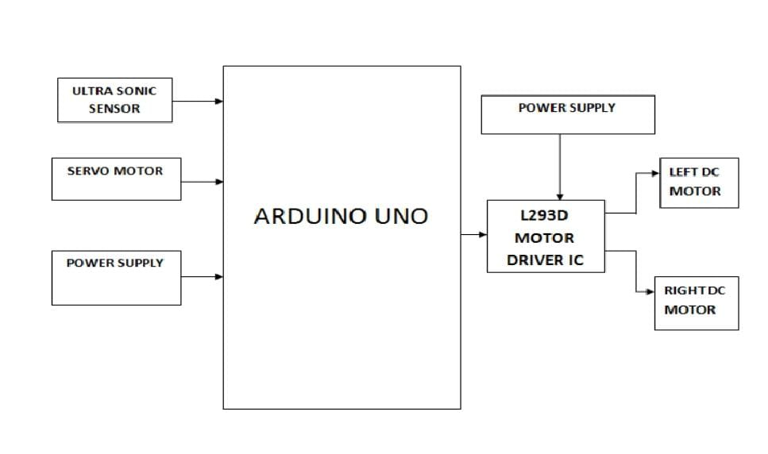
Architecture
1. The ultrasonic sensor scans the area.
2. The servo motor rotates the sensor to check multiple directions.
3. Based on distance values, the Arduino with motor shield makes decisions :
>Move forward if the path is clear
>Stop or turn if an obstacle is detected.
4. DC motors receive commands from the motor shield to execute the movement.
5. Power is continuously supplied by the Li-ion battery pack
Department of CSE – (IoT & CSBT) 2025-26

Slide 12
Algorithm Used
1. Start
2. Initialize System
Power ON
Initialize Arduino, ultrasonic sensors, and motors
3. Read Sensor Data
Continuously measure distance using ultrasonic sensors
4. Check Obstacle Presence
If distance < threshold → Obstacle detected
Else → Path is clear
5. Decision Making
Obstacle detected: Determine direction to turn (left/right/back)
No obstacle: Move forward
6. Move Robot
Execute motor commands based on decision
7. Loop
Repeat reading sensors and decision-making until Stop command
8. Stop
Stop motors and end operation
Department of CSE – (IoT & CSBT) 2025-26

Slide 13
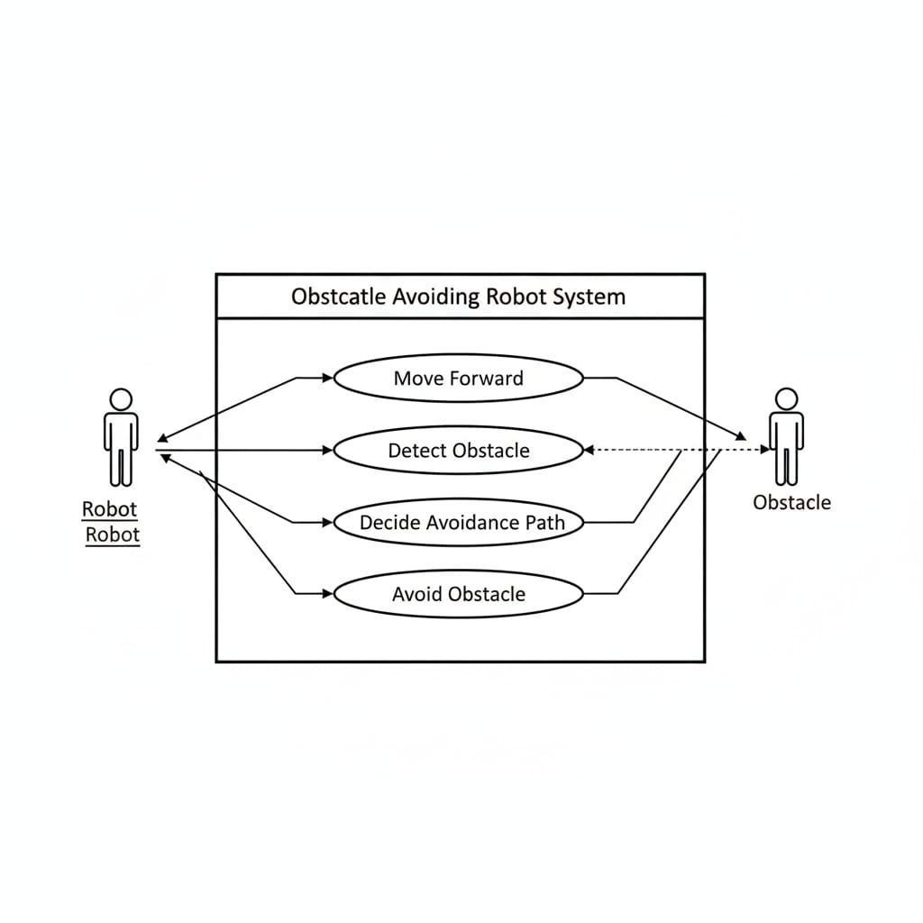
Use case diagram
Department of CSE – (IoT & CSBT) 2025-26

Slide 14
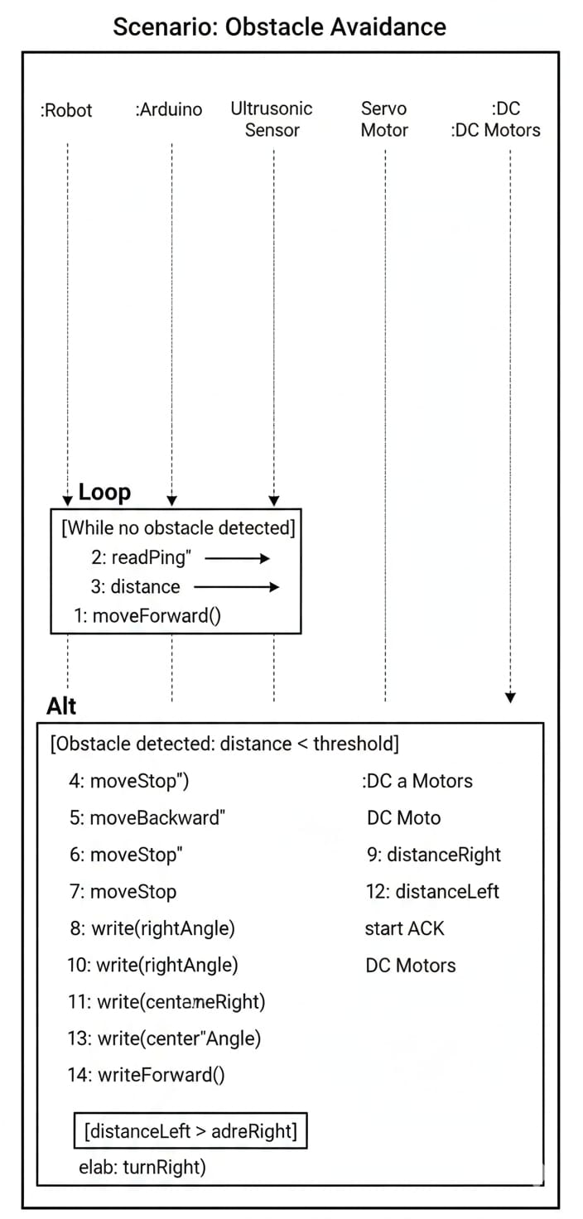
Sequence diagram

Slide 15
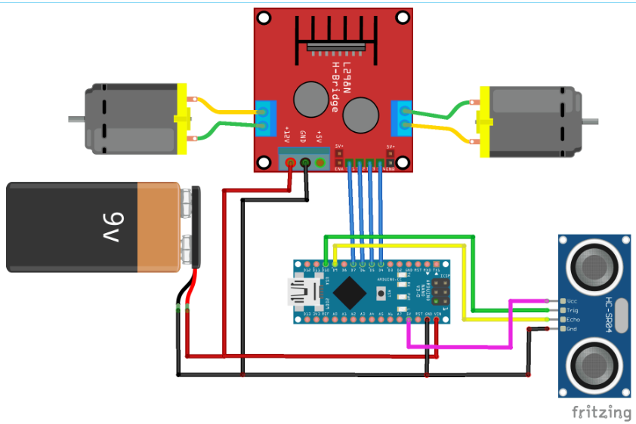
Implementation
Current trend tools usage
Arduino
Acts as the main microcontroller that controls the motors and reads
sensor input.
L298N Motor Driver Module
Used to control the speed and direction of two DC motors.
Connected to Arduino for control signals and powered by the 9V battery.
2 × DC Motors
These are the drive motors connected to the L298N output terminals.
They move the robot forward, backward, or turn.
HC-SR04 Ultrasonic Sensor
Measures distance to obstacles in front of the robot using sound waves.
Connected to Arduino for Trig and Echo pins.
9V Battery
Powers the entire circuit (motor driver, motors, and Arduino via the VIN pin).
Wiring Connections
Power (red for +V, black for GND)
Signal lines (various colors for control and sensor signals)

Slide 16
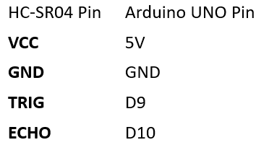

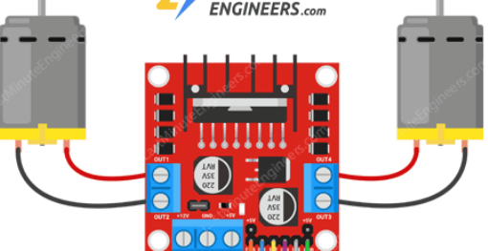
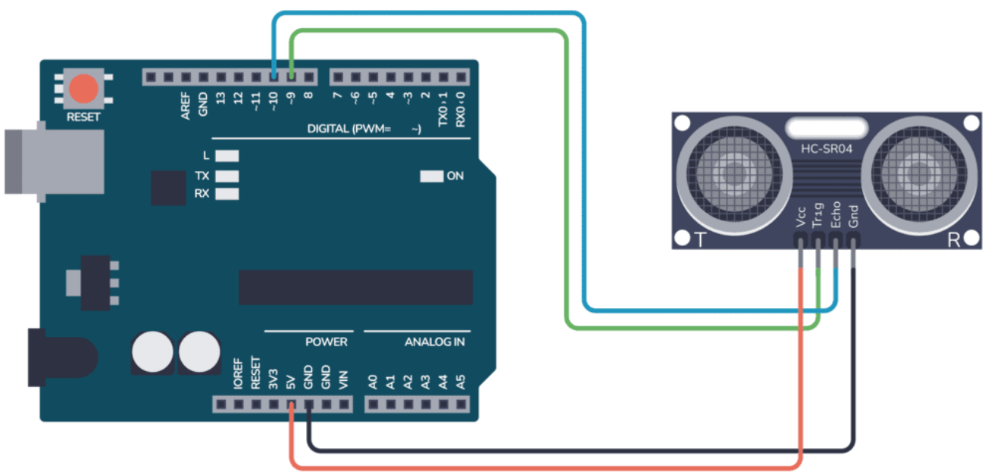
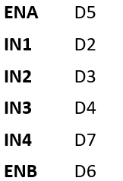
Connections of components
1. Power Connections
9V Battery (+) →12V pin on L298N Motor Driver
9V Battery (–) →GND on L298N Motor Driver
2.L298N Motor Driver → DC Motors
OUT1, OUT2 → Motor A terminals
OUT3, OUT4 → Motor B terminals
3.L298N Motor Driver → Arduino
4. HC-SR04 Ultrasonic Sensor → Arduino UNO

Slide 17
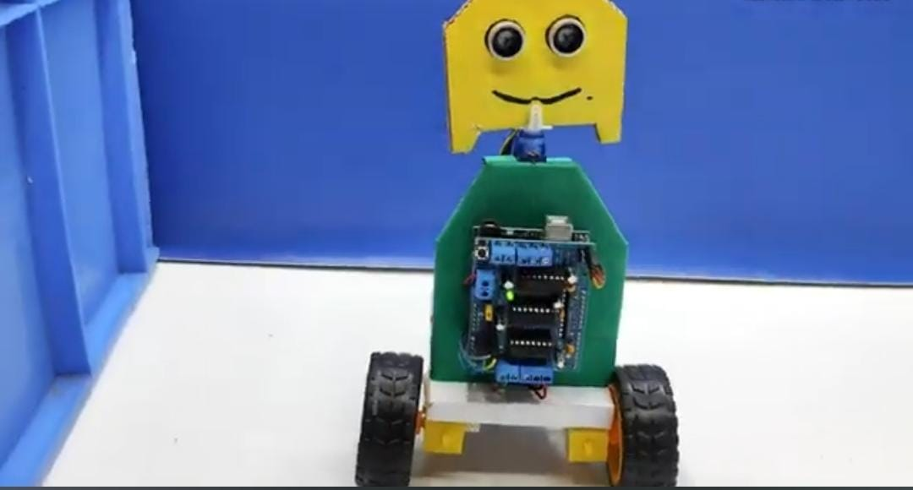
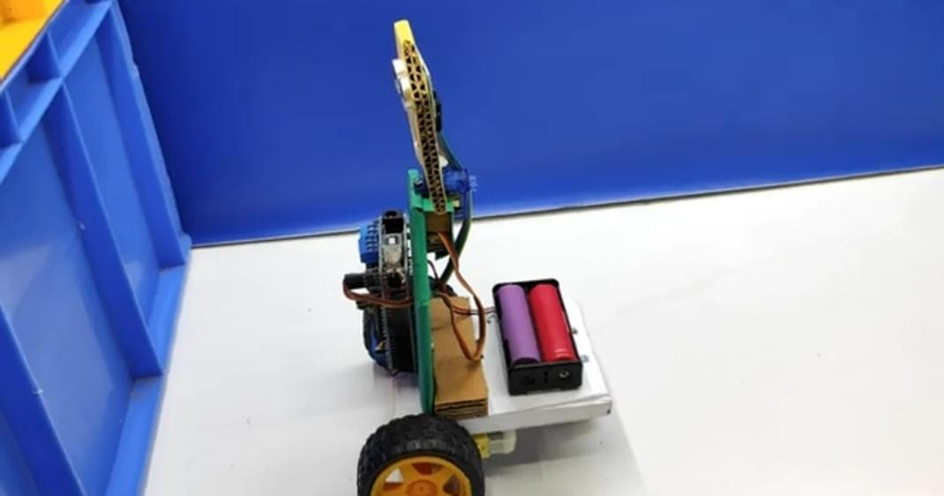
Results
​The project successfully resulted in an autonomous obstacle avoiding robot governed by the provided Arduino code.
​​Autonomous Navigation: The robot is capable of operating without direct human control.
​Collision Avoidance: Using the Ultrasonic Sensor (HC-SR04), the robot accurately measures the distance to objects in its path.​
Intelligent Decision-Making: When an obstacle is detected (distance \le threshold), the robot stops, briefly backs up, and uses the Servo Motor to sweep the sensor left and right to determine the clearest path.
​Path Correction: Based on the distance measurement, the robot initiates a turn (left or right) using the DC Motors to navigate around the obstacle before resuming forward movement.​
The final result is a functional system that continuously executes the Sense ->Decide -> Act loop, fulfilling the core objective of autonomous obstacle avoidance.

Slide 18
Result Analysis
The project is a successful autonomous obstacle avoiding robot.
​The analysis confirms three key functional results:​
1.Effective Sensing: The Ultrasonic Sensor reliably detects obstacles by continuously measuring distance (d) and triggering the avoidance sequence when d <=Threshold.
2.​Intelligent Decision-Making: The Servo Motor enables the robot to scan the environment, compare clearance on the left (dLeft) and right (d Right) sides, and correctly choose the path with maximum distance.​
3.Coordinated Actuation: The DC Motors execute precise actions (moveBackward(), turnLeft()/turnRight()) followed by calculated delays to ensure physical movement is complete before resuming forward travel, resulting in smooth obstacle bypass.
​In short, the robot demonstrates robust, reactive control for autonomous navigation.

Slide 19
Conclusion
The Arduino-based obstacle-avoiding robot project successfully demonstrates the application of embedded systems and sensor-based automation in robotics. By integrating key hardware components such as the Arduino Uno, ultrasonic sensor, motor driver module, and DC motors, the robot achieves autonomous navigation by detecting and avoiding obstacles in real-time. The ultrasonic sensor plays a crucial role in continuously monitoring the robot’s surroundings, while the Arduino processes the input data and controls
the motor movements accordingly. This project offers a low-cost, beginner-friendly platform to understand the fundamentals of autonomous robotics, including sensor interfacing, real-time decision-making, and movement control.

Slide 20
References
Arduino Motor Shield Library
Arduino provides an official Motor Shield Library that facilitates controlling DC motors
and stepper motors. This library simplifies PWM signal generation and direction control,
essential for obstacle-avoiding robots.
Servo Library
The Servo.h library is crucial for controlling servo motors, such as those used for rotating
ultrasonic sensors. It enables precise angular movement using PWM signals.
NewPing Library (Ultrasonic Sensor)
The NewPing library simplifies interfacing with the HC-SR04 ultrasonic sensor, providing more accurate distance measurement and reducing signal noise.
Arduino IDE and Programming Resources
The official Arduino IDE and reference documentation provide essential guidance on
writing and uploading code for obstacle-avoidance robots
Department of CSE – (IoT & CSBT) 2025-26

Slide 21


